Slide 1
PROJECT TITLE:-Pizza-World-Online Food Delivery Website
C.K.PITHAWALLA COLLEGE OF COMMERCE MANAGEMENT AND COMPUTER-APPLICATION
Group No:- 33
Submited By:- Vamja Vardhit P.
Gohil Divyraj M.
Zanzmera Pooja B.
Guided By:- Dr. Ami Desai
1

Slide 2
Personal Profile
Exam No | 7275
Name | Vamja Vardhit P.
Email Address | vamjavardhit461@gmail.com
Phone no | 8238648728
Exam No | 7188
Name | Gohil Divyraj M.
Email Address | divyrajsinhgohil9585@gmail.com
Phone no | 9512128080
2

Slide 3
Personal Profile
Exam No | 7285
Name | Zanzmera Pooja B.
Email Address | poojazanzmera31@gmail.com
Phone no | 9879719578
3

Slide 4
Overview
Introduction
Scope & Planning
Technologies & Tools
Testing
UML DIAGRAMS
Table Structure
Conclusion
Bibliography
4

Slide 5
Introduction Summary:-
Pizza-World is an online food delivery website designed to provide a seamless ordering experience for customers. The platform allows users to browse multiple food categories such as Pizza, Burgers, Beverages, and more, customize their orders, and make payments through online payment methods or Cash on Delivery (COD).
The system consists of three panels: 1️⃣ User Panel – Customers can sign up, log in, view food items, add favorites, customize item sizes (Small, Medium, Large), add to cart, and place orders. 2️⃣ Admin Panel – The admin manages users, food categories, orders, and delivery boys, assigns orders, and monitors payments. 3️⃣ Delivery Boy Panel – Delivery personnel sign up, get admin approval, view assigned orders, mark deliveries, and receive customer reviews.
5

Slide 6
Once an order is placed, the admin assigns it to an available delivery boy for fulfillment. Both the admin and delivery boy receive a 10% commission from the total payment. After successful delivery, customers can leave reviews and ratings based on their experience.
This project ensures a user-friendly, efficient, and well-managed food ordering and delivery system, making it a one-stop solution for online food lovers.
6

Slide 7
Scope & Planning:-
Pizza-World is an online food delivery system designed to provide a seamless experience for customers, admins, and delivery personnel. The project focuses on efficient order management, food customization, secure payments, and delivery tracking.
User Features: ✔️ Browse multiple food categories (Pizza, Burger, Beverages, etc.). ✔️ Add favorite items to a dedicated Favorites Page. ✔️ Customize food size (Small, Medium, Large). ✔️ Add to cart and place orders with Online Payment or Cash on Delivery (COD). ✔️ Track order history and provide feedback.
🔹 Admin Features: ✔️ Manage users, delivery boys, and food categories (Add, Update, Delete). ✔️ Assign orders to delivery boys in real time. ✔️ Monitor order status and payments. ✔️ View customer feedback and contact messages. ✔️ Earn 10% commission per order.
7

Slide 8
🔹 Delivery Boy Features: ✔️ Sign up and wait for admin approval. ✔️ View assigned and pending orders. ✔️ Mark orders as delivered and check user feedback. ✔️ Earn 10% commission per order.
🔹 Payment & Commission System: ✔️ Users can pay via online payment (UPI, Debit/Credit Card, Net Banking) or COD. ✔️ Admin and delivery boys receive 10% commission per order.
8

Slide 9
Project Planning & Timeline:-
Phase 1: Requirement Analysis & Design (Week 1-2)
✔️ Define project goals and features. ✔️ Design database schema (OPD Database). ✔️ Create wireframes and UI/UX design for each panel.
Phase 2: Frontend & Backend Development (Week 3-6)
✔️ Develop the User Panel (Sign up, Login, Menu, Cart, Order, Favorites). ✔️ Develop the Admin Panel (Manage users, food items, orders, delivery boys). ✔️ Develop the Delivery Boy Panel (Orders, Status updates, Reviews). ✔️ Implement Payment Gateway Integration.
9

Slide 10
Phase 3: Testing & Debugging (Week 7-8)
✔️ Test all user flows (Signup, Order Placement, Payment, Order Tracking). ✔️ Fix bugs and improve performance. ✔️ Ensure mobile responsiveness.
Phase 4: Deployment & Launch (Week 9-10)
✔️ Deploy on a live server. ✔️ Conduct user training and feedback collection. ✔️ Market the platform to attract users and delivery personnel.
10

Slide 11
TECHNOLOGIES:-
CSS
PHP
FRONT-END
HTML
MYSQL & PHP
BACK-END
Java-script
J-Query
Use-Languages

Slide 12
TOOLS:-
DOCUMENTATION TOOLS DEVELOPMENT TOOLS
TEXT-EDITOR
MS-WORLD
VISULAL STUDIO TOOLS

Slide 13
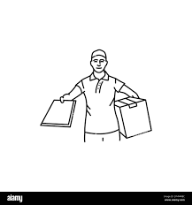


Panel-Interface:-
Delivery guy
Delivered a orders item to a user
User
Admin
All items show and order
Manage all items and other Servies
6

Slide 14

UML Diagram:-
View Categories
View Menu
Login
Like Items
Sign up
Add to Cart
Order a Items
Traking Order
Make Inquiry
User
Give Feedback
Logout
Manage Profile

Slide 15
Manage Menu
Manage Orders
Manage Categories
Manage dashboard
View Inquiry
Login
Manage Feedback
Manage Users
Manage Delivery boy
Manage site- Details
Admin
Manage Profile
Logout

Slide 16
Manage Dashboard
View Assigned Orders
Login
Sign up
Change Order Status
View all Orders
View Feedback
View Total Payouts
Delivery boy
Manage Profile
Logout

Slide 17
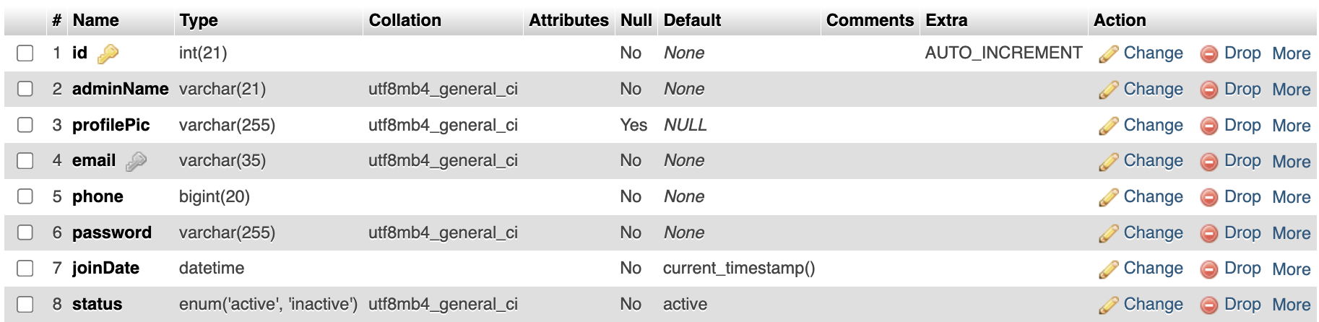
Table-Structure:-
Table-name:- Admin
Use:- the admin table stores administers details , including login credentials , Profile Information, and status, for managing the system.

Slide 18
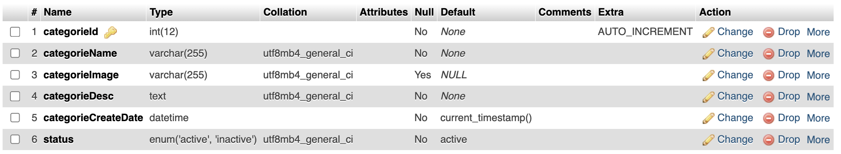
Table-name:- categories
Use:-This table stores different categories of pizzas, such as Veg, Non-Veg, Cheese Lovers, etc. It helps organize pizzas into groups, making browsing easier for users.

Slide 19
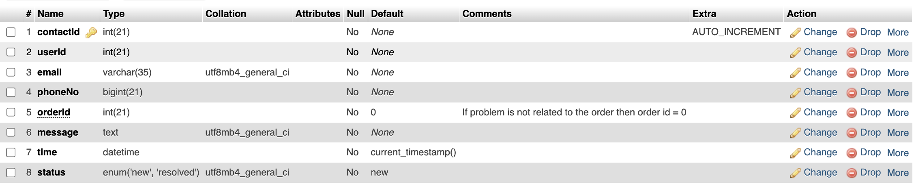
Table-name:- contact
Use:- This table records customer inquiries or complaints submitted through the contact form. It links the message to a userId and optionally to an orderId if the issue is order-related.

Slide 20
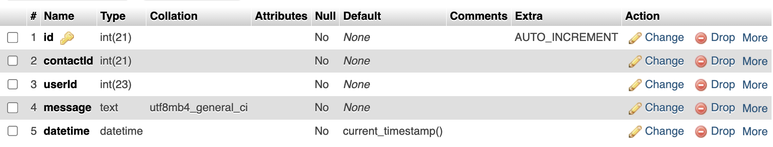
Table-name:-contactreply
Use:-Stores replies from the admin or support team to customer inquiries. It links back to the contactId to maintain a conversation thread.

Slide 21
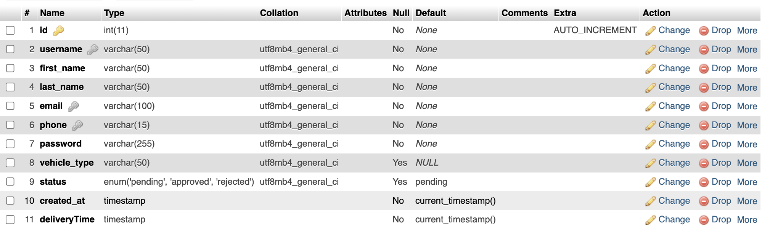
Table-name:-delivery_boys
Use:-Maintains information about delivery personnel, including their login credentials, vehicle type, and status. It helps in assigning orders to delivery agents.

Slide 22
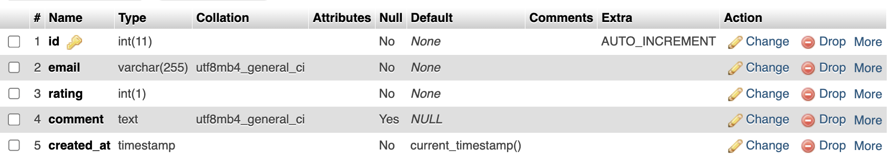
Table-name:-feedback
Use:-Stores customer feedback, including email, rating (1-5), and optional comments. This helps in analyzing customer satisfaction.

Slide 23
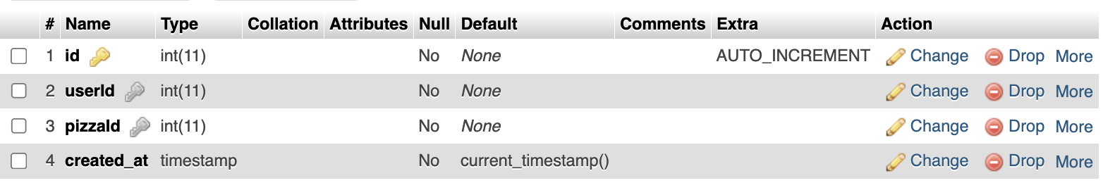
Table-name:-likes
Use:-Keeps track of pizzas liked by users, allowing the website to show trending or most-liked pizzas.

Slide 24
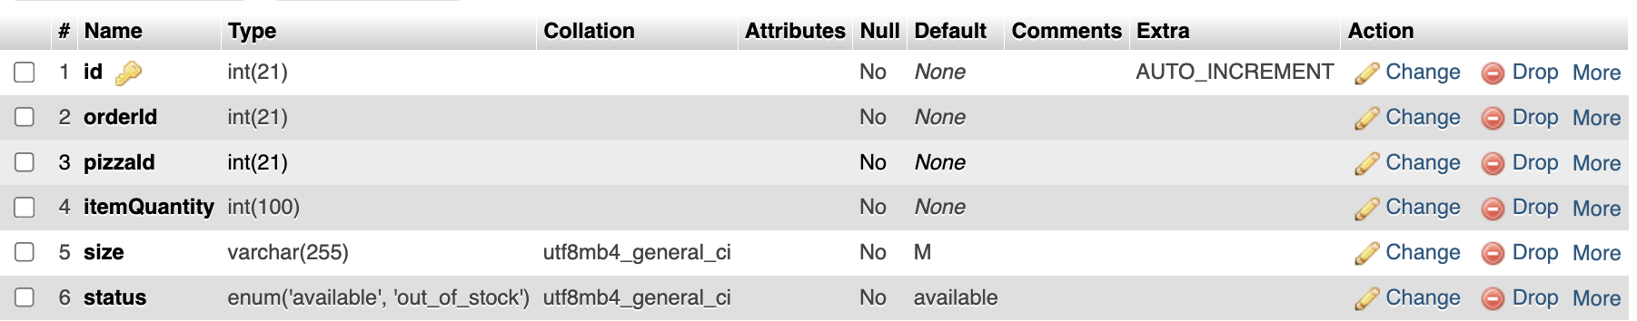
Table-name:-orderitems
Use:-Stores details of individual items within an order, including the pizza ordered, quantity, size, and availability status.

Slide 25
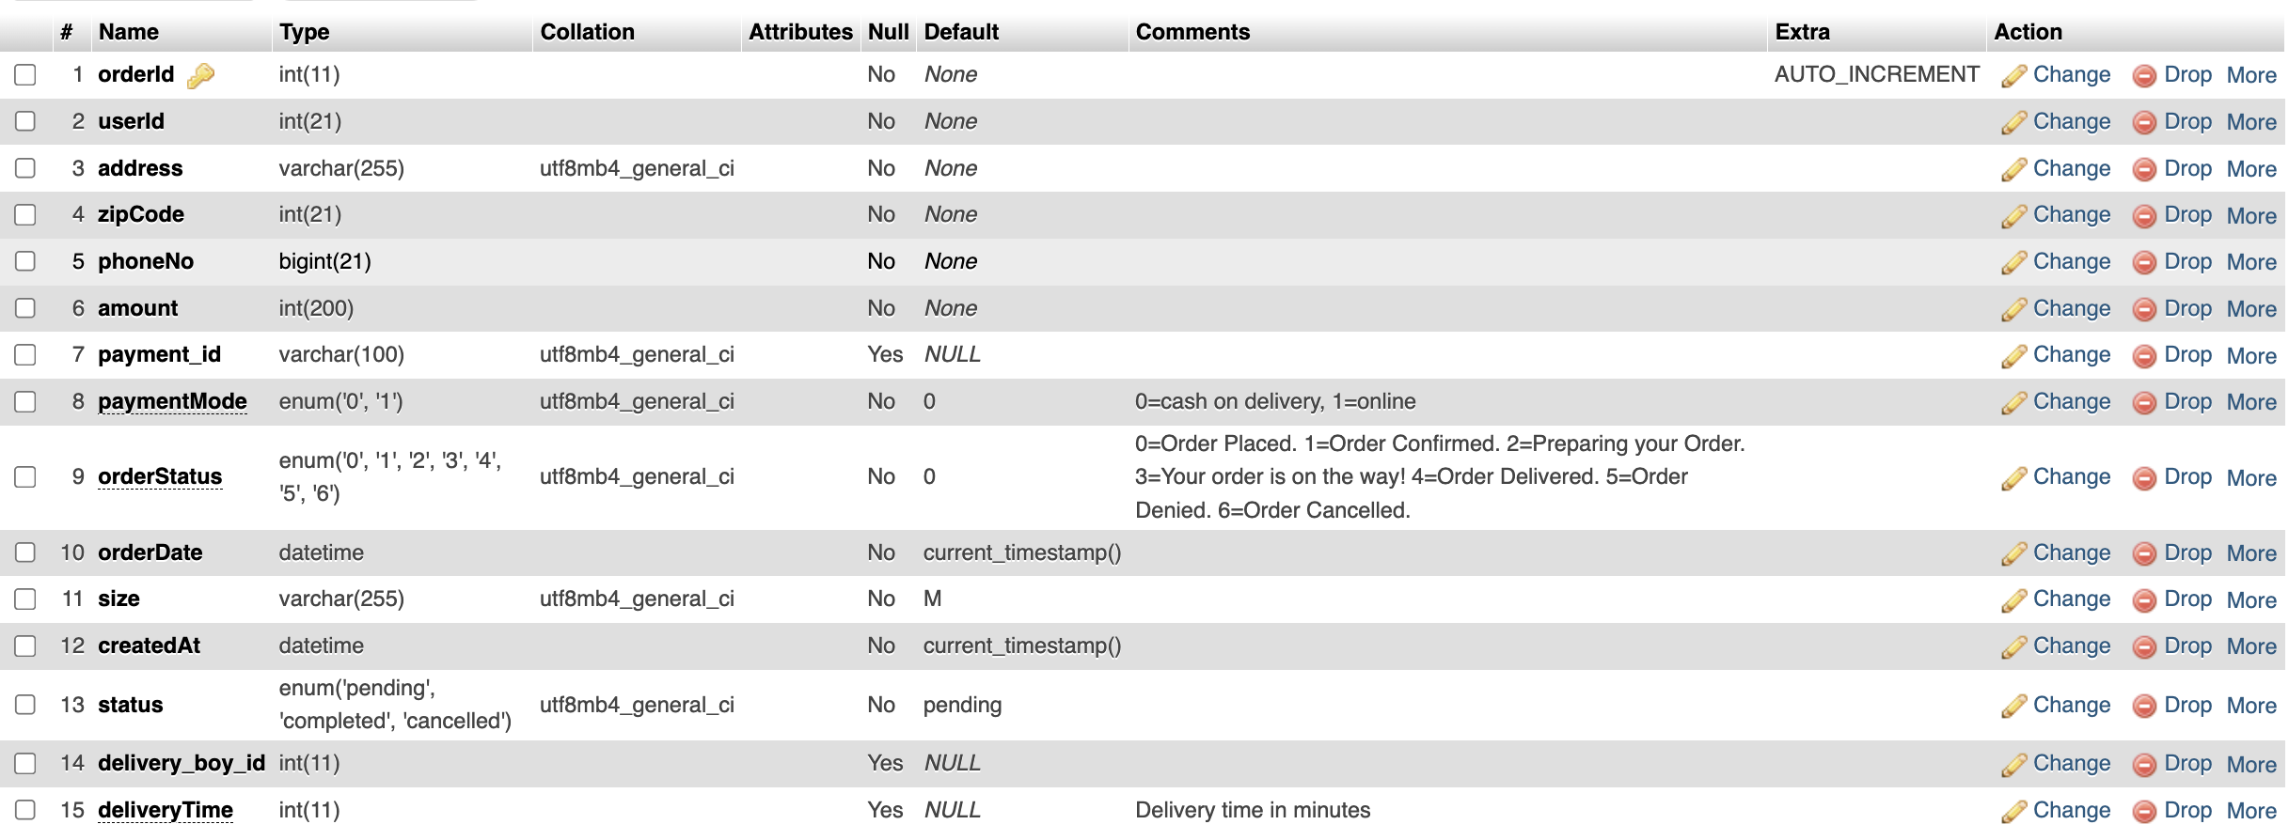
Table-name:-orders
Use:-Maintains records of customer orders, including user details, order amount, payment method (cash or online), order status (placed, confirmed, delivered, etc.), and assigned delivery boy.

Slide 26
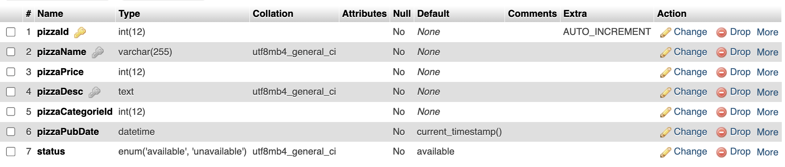
Table-name:-pizza
Use:-This table contains information about pizzas available for order, including name, price, description, category, and availability status.

Slide 27
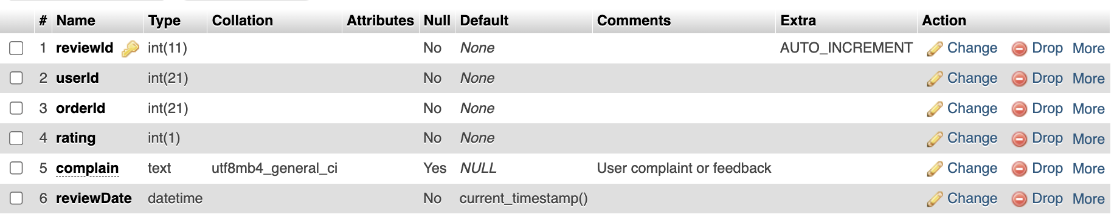
Table-name:-reviews
Use:-Stores customer reviews and complaints related to orders. Each review is linked to a userId and orderId, and includes a rating (1-5) and optional complaint text.

Slide 28
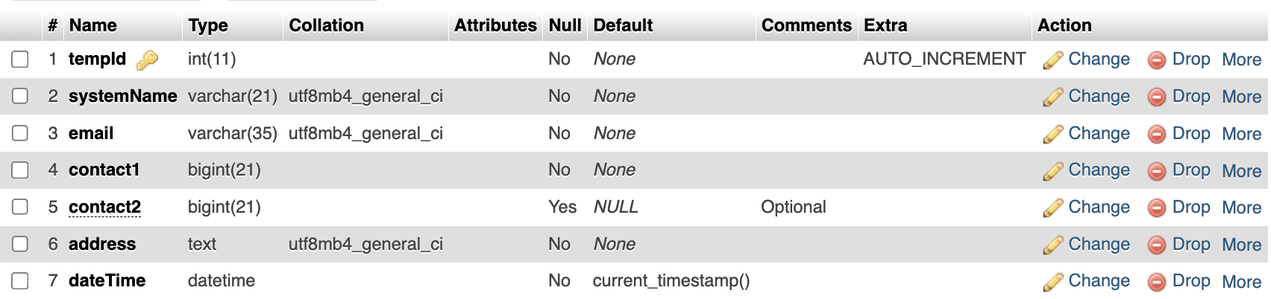
Table-name:-sitedetail
Use:-Stores website-related details like system name, email, contact numbers, and address. This is useful for website settings and customer support information.

Slide 29
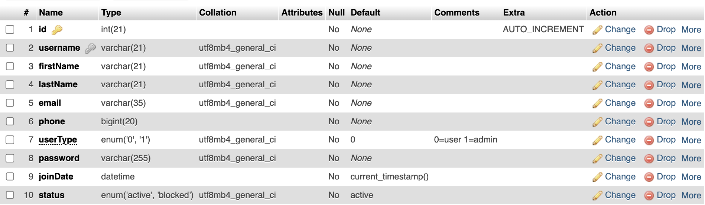
Table-name:-users
Use:-Maintains user account information, including login credentials, name, contact details, account type (user/admin), and status (active/blocked).

Slide 30
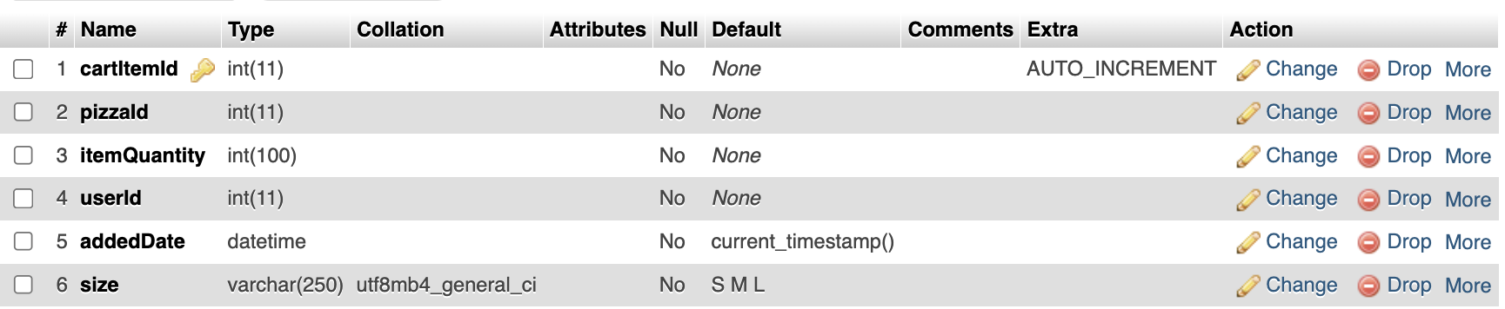
Table-name:-viewcart
Use:-Stores items added to the shopping cart by users before placing an order. It tracks the pizza ID, quantity, selected size, and the user who added it.

Slide 31
Conclusion
The Pizza-World online food delivery system has been successfully designed and implemented to provide a seamless, user-friendly experience for customers, administrators, and delivery personnel. This project efficiently integrates food ordering, order management, and delivery tracking into a single platform, ensuring smooth and secure transactions. With a well-structured User Panel, Admin Panel, and Delivery Boy Panel, the system allows users to browse various food categories, customize their orders, add favorite items, and place orders using either online payment or cash on delivery (COD).
I must tell you that if you are looking for such an online system for your business then you are at the right place. Feel free to contact me for this project or similar projects like the online ordering system for a Restaurant. Through a thorough Requirement Analysis and Feasibility Analysis, we identified the needs and expectations of our target users and determined the technical and financial viability of the project.
15

Slide 32
Biblography
Website :-
http://www.php.net
http://www.mysql.net
https://www.w3school.com
https://stackoverflow.com/
https://www.pizzahut.co.in/
https://chatgpt.com/
16

Slide 33

17

Slide 34

Any Questions?
18

